Slide 1


CSS3
The Latest Standard for CSS

Slide 2
Introduction
CSS3 - Cascading Style Sheets Level 3.
CSS3 offers several new features that really help us in web design and web development.
CSS3 has taken a very large step forward in helping web developers get away from importing mass amounts of images/JavaScript and making it possible to do this only by using pure CSS.
The CSS3 specification is still under development by W3C.

Slide 3

CSS3 Prefixes
A way for browser makers to add support for new CSS features in a sort of testing and experimentation period.
-o-
-webkit-
-ms-
-moz-
-webkit-

Slide 4
CSS3 Modules
CSS3 is split up into "modules".
Selectors
Box Model
Backgrounds and Borders
Text Effects
2D/3D Transformations
Animations
Multiple Column Layout

Slide 5
CSS3 2D Transforms
With CSS3 transform, we can move, scale, turn, spin, and stretch elements.
How Does it Work?
A transform is an effect that lets an element change shape, size and position.
2D Transform methods
Translate()
Rotate()
Scale()
Skew()
Matrix()

Slide 6
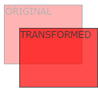
Transform Translate
With the translate() method, the element moves from its current position, depending on the parameters given for the left (X-axis) and the top (Y-axis) position.
Example transform: translate(50px,100px);

Slide 7

Transform Rotate
With the rotate() method, the element rotates clockwise at a given degree. Negative values are allowed and rotates the element counter-clockwise.
Example
transform: rotate(30deg);

Slide 8
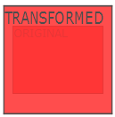
Transform Scale
With the scale() method, the element increases or decreases the size, depending on the parameters given for the width (X-axis) and the height (Y-axis).
Example
transform: scale(2,4);

Slide 9
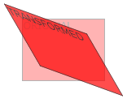
Transform Skew
With the skew() method, the element turns in a given angle, depending on the parameters given for the horizontal (X-axis) and the vertical (Y-axis) lines.
Example
transform: skew(30deg,20deg);

Slide 10
Transform Matrix
The matrix() method combines all of the 2D transform methods into one.
The matrix method take six parameters, containing mathematic functions, which allows you to: rotate, scale, move (translate), and skew elements.
Example
transform: matrix(0.866,0.5,-0.5,0.866,0,0);

Slide 11
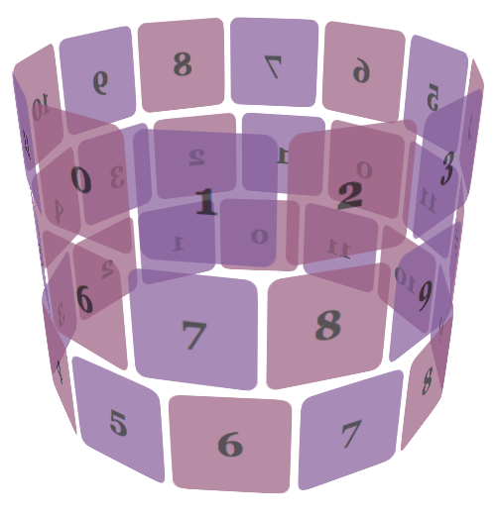
3D Transforms
3D transform methods:
rotateX()
rotateY()
Internet Explorer, Firefox, and Opera does not yet support the 3D transform methods. Chrome and Safari requires the prefix -webkit-.

Slide 12

3D Transform Rotate X
With the rotateX() method, the element rotates around its X-axis at a given degree.
Example
transform: rotateX(120deg);

Slide 13

3D Transform Rotate Y
With the rotateY() method, the element rotates around its Y-axis at a given degree.
Example
transform: rotateY(130deg);

Slide 14
CSS3 Transitions
With CSS3, we can add an effect when changing from one style to another, without using Flash animations or JavaScript.
How does it work?
CSS3 transitions are effects that let an element gradually change from one style to another.
To do this, must specify two things:-
Specify the CSS property you want to add an effect to
Specify the duration of the effect.

Slide 15
CSS3 Animations
With CSS3, we can create animations, which can replace animated images, Flash animations, and JavaScripts in many web pages.
CSS3 @keyframes Rule
The @keyframes rule is where the animation is created. Specify a CSS style inside the @keyframes rule and the animation will gradually change from the current style to the new style.

Slide 16
CSS3 Animations
When the animation is created in the @keyframe, bind it to a selector, otherwise the animation will have no effect.
Bind the animation to a selector by specifying at least these two CSS3 animation properties:
Specify the name of the animation.
Specify the duration of the animation.

Slide 17
CSS3 Animations
An animation is an effect that lets an element gradually change from one style to another.
You can change as many styles you want, as many times you want.
Specify when the change will happen in percent, or the keywords "from" and "to", which is the same as 0% and 100%.
0% is the beginning of the animation, 100% is when the animation is complete.

Slide 18
CSS3 Animations
Example
@keyframes myfirst{
0% {background: red;} 25% {background: yellow;} 50% {background: blue;} 100% {background: green;}
} @-webkit-keyframes myfirst Safari and Chrome{
0% {background: red;} 25% {background: yellow;} 50% {background: blue;} 100% {background: green;} }

Slide 19
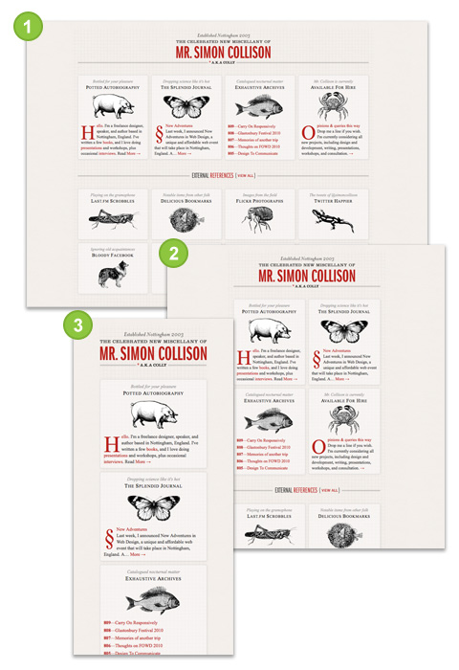
CSS3 Media Queries
Media queries will allow us to change our layouts to suit the extract need of different devices – without changing the content
CSS can be used to specify how a document is presented in different media.

Slide 20
Media query syntax: internal
Make the background gray. But up to a maximum width of 500 pixels, make the background blue.
body {
background: gray;
}
@media screen and (max-width:500px) {
body {
background: blue;
}
}

Slide 21
Media query syntax: external
Extend the existing media part of the link element or @import rule:
<link href="narrow.css" rel="stylesheet"
media="only screen and (max-width:500px)">
@import url(narrow.css) only screen and
(max-width:500px);

Slide 22

Question Time

